Slide 1
Summer Semester 2022 -23
Internet Of Things (IOT)
Final Review
Submitted By —
22MCA0365 - Priya Nayak
22MCA0390 - Palak Nandani
22MCA0391 - Ankit Kumar

Slide 2
Smart Greenhouse Monitoring System using IOT

Slide 3
CONTENTS:
ABSTRACT
INTRODUCTION
PROBLEM STATEMENT
ARCHITECTURE DIAGRAM
FLOWCHART
SOFTWARE REQUIREMENT
HARDWARE REQUIREMENT
IOT DASHBOARD

Slide 4
Abstract
The smart system for greenhouses is made using technology called Internet of Things(IoT) which helps to improve the way plants are grown and resources are managed. It uses small wireless devices placed throughout the greenhouse to measure important things like temperature, humidity, light, soil moisture, and carbon dioxide levels. These devices send this information to a central hub, which processes and analyzes the data. Users can access this information through a website or a phone app. The system also allows users to automatically control things like fans, watering systems, and shading based on specific rules. By using IoT, this smart greenhouse monitoring system helps create optimal conditions for plants, saves resources, increases productivity, and offers a more sustainable solution for modern farming.

Slide 5
Introduction
Greenhouses are designed to protect plants from harsh environmental conditions and provide a controlled growth environment. Monitoring the environmental conditions inside the greenhouse is essential for optimal plant growth. Traditional greenhouse monitoring requires manual observation, but by implementing IoT techniques, it can be monitored remotely from any location. Various sensors are used to monitor the greenhouse and take appropriate actions based on the sensed parameters. The system is set up with predefined conditions by the operator to ensure that the plants are not adversely affected by environmental variations.

Slide 6
Problem Statement
The problem we're addressing is that traditional greenhouse monitoring methods are not efficient and often require manual work. This leads to difficulties in maintaining the ideal conditions for plants to grow and can result in wasted resources and lower productivity. Additionally, it's challenging to monitor and control the greenhouse from a distance.
To solve these problems, we need a smart greenhouse monitoring system using IoT. This system would allow us to monitor the greenhouse in real-time, even from far away. We can keep track of important factors like temperature, humidity, light, soil moisture, and carbon dioxide levels. The system would also let us automate the control of greenhouse equipment based on predefined rules. By doing this, we can ensure that plants have the best possible conditions for growth, save resources, increase productivity, and make greenhouse farming more sustainable.

Slide 7
Architecture Diagram
The block diagram in Cisco Packet Tracer shows a Smart greenhouse system that uses IoT technology. It consists of different systems like temperature and humidity monitoring, fire and CO2 detection, smart lighting, moisture monitoring, solar energy generation, and a smart door system. All these devices are connected through the internet, allowing them to communicate with each other. To monitor and control the greenhouse, a smartphone is used. The system uses wireless devices for easy connectivity and operation.

Slide 8
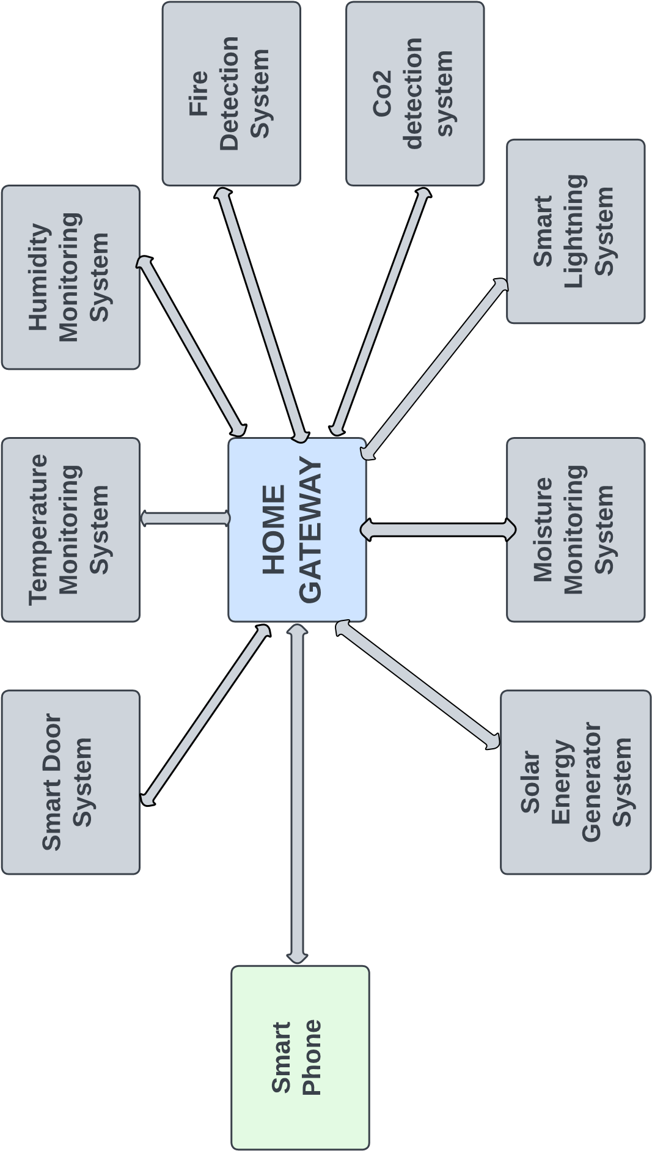
Fig. 1

Slide 9
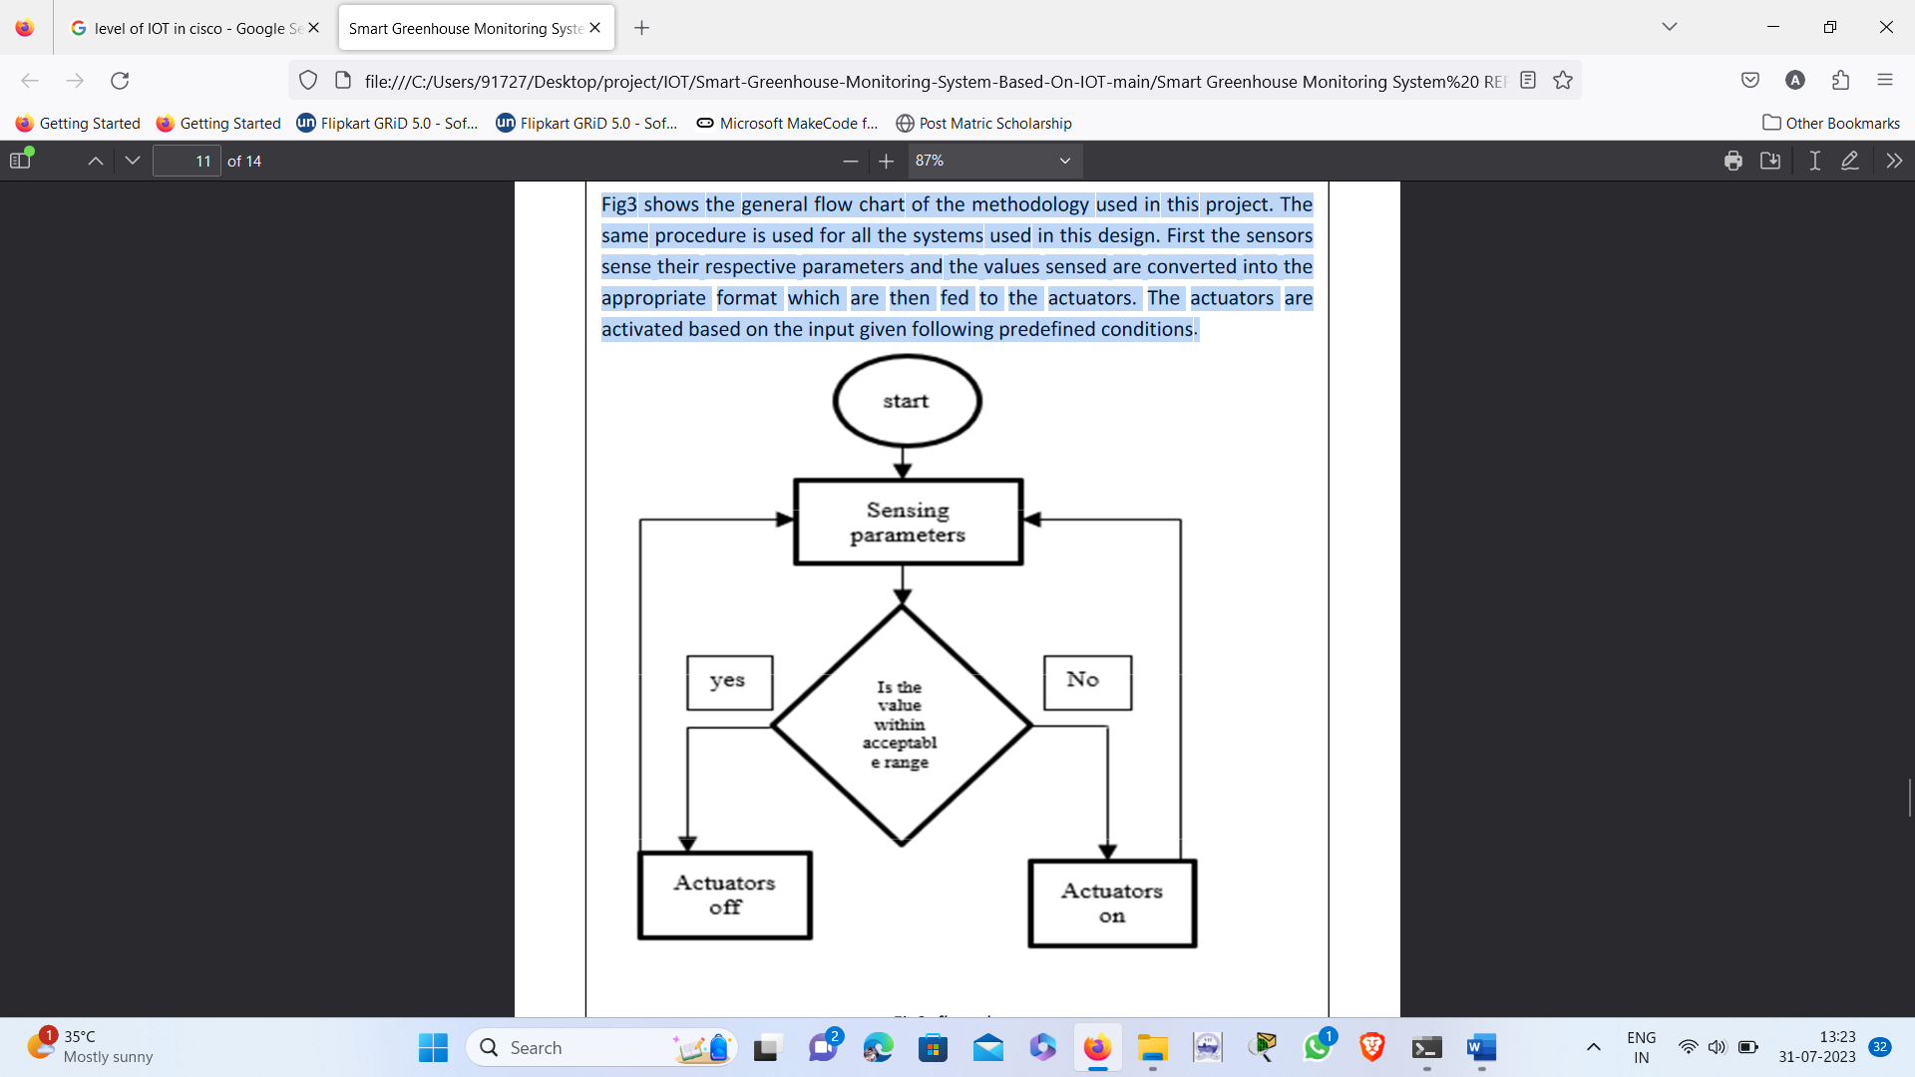
Flowchart
In Fig.2 shows the general flow chart of the methodology used in this project. The same procedure is used for all the systems used in this design. First the sensors sense their respective parameters and the values sensed are converted into the appropriate format which are then fed to the actuators. The actuators are activated based on the input given following predefined conditions.
Fig. 2

Slide 10
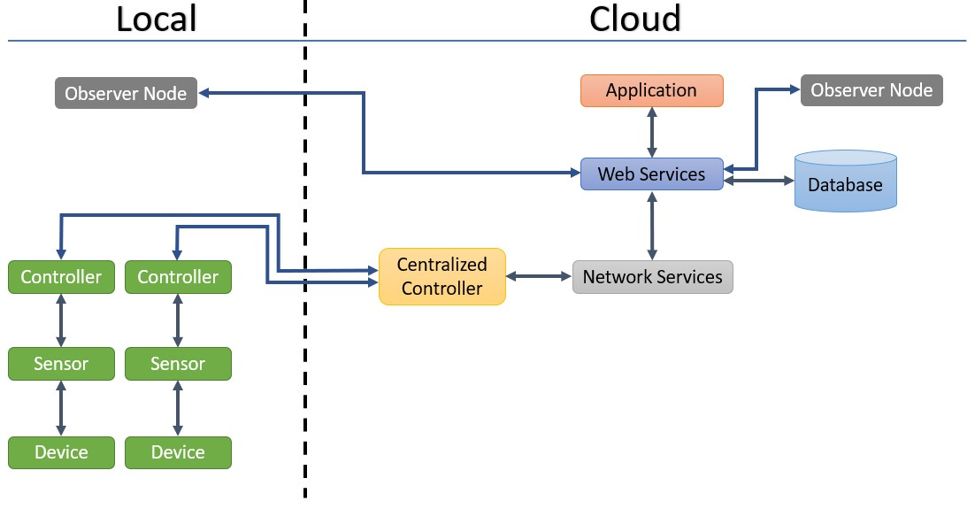
IOT Level
LEVEL 6
Fig. 3

Slide 11

Software Requirement
a. Operating System like Raspbian and Linux , windows
b. Cisco Packet Tracer
c. Mobile Application
d. Networking protocols like HTTP/HTTPS
e. TLS/SSL for data integrity and confidentiality.

Slide 12
Hardware Requirement
a. Thermostats, heating elements, and cooling elements
b. LED or monitor.
c. Humidity sensors, humidifiers.
d. Smoke detector, fire sprinkler, Siren
e. CO2 detector, exhaust fan.
f. Water level monitor, lawn sprinkler
g. Solar panel, power meter, and battery.
h. RFID valid card, RFID invalid card and RFID reader.
i. Lamp

Slide 13
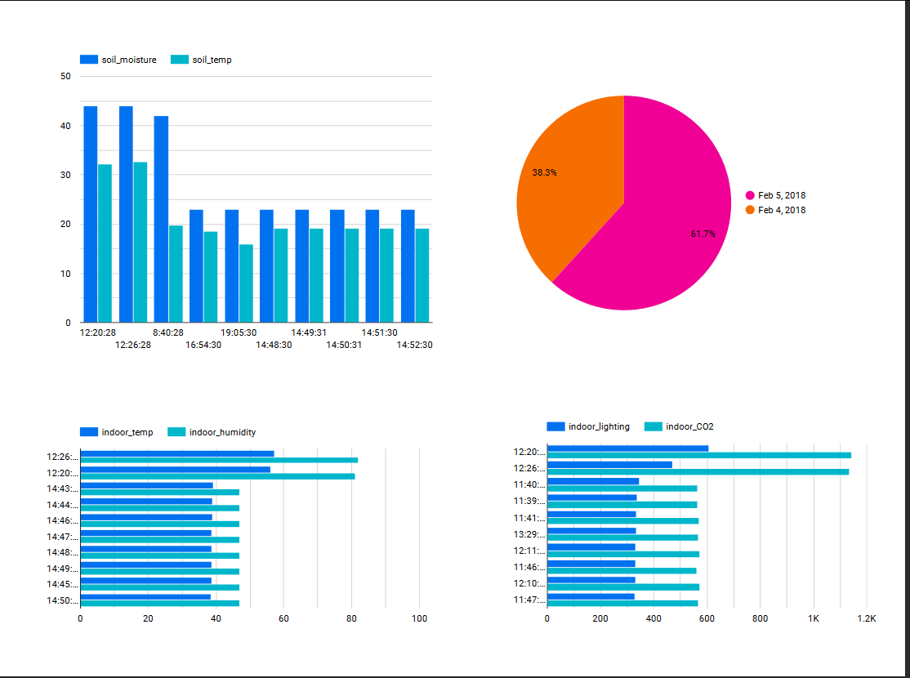
IOT DASHBOARD

Slide 14
Thank you!

